Slide 1
Deliver business outcomes with speed and agility
Richelieu Richardson
ITBM Senior Advisory Solution Consulting
Notes:
Today we want to talk to you about Delivering Business Outcomes with Speed and Agility on the ServiceNow platform.

Slide 2









A Single System of Action
Customer Service
Service
Management
Finance
Marketing
Customer
Service
HR
Legal
Field
Services
Facilities
HR
ServiceNow
Platform
Security
Incident Response
Asset
Change & Release
Service
Catalog
Service
Portal
Peer
Benchmarking
Knowledge
Base
Vulnerability
Response
Service
Levels
Performance Forecasting
Problem
Threat Intelligence
Reports & Dashboards
SecOps & GRC
Incident
Predictive Modeling
Risk
Subscription & Notification
Audit
Demand
Anomaly Detection
Compli-
ance
Contextual
Collaboration
Resource
Orchestration
Vendor
Developer
Tools
Single
Database
Workflow
Project
& Portfolio
Cloud
Management
Agile
Development
& Test
App Portfolio
Event
Management
Orchestration
IT Business
Management
Service
Mapping
Financial
Management
Discovery
IT Operations
Management
Notes:
Talk about where ITBM Fits in the overall portfolio
ITBM is a key component of the ServiceNow platform. Essentially, making sure IT is Aligned with the business

Slide 3


We make the world of work, work better for people.
Customer Experience
Employee Experience
Business
IT
The intelligent and intuitive platform for work.
Now Platform: The intelligent and intuitive cloud platform for work.TM
Customer Workflows
IT Workflows
Employee Workflows
Digital workflows that create great experiences and unlock productivity.
Notes:
The intelligent and intuitive cloud platform for work.
Intelligence - customers want Machine Learning applied to everyday work - want our help to prioritize, categorize and route tasks to the right people in the organization. Through anomaly detection, they want to predict issues before they happen.
Intuitive - we understand the context of work, context of what users are trying to do, problems they have so we can provide relevant solutions - mobile experiences, with a slide of a finger
Integrated - Integrations, common data model that allow work across the enterprise
With the platform, we deliver digital workflows that create great experiences and unlock productivity.
Great experiences aren't just about the visual user experiences, pixels on the screen, it's about understanding how humans work, and how the work they do flows across the organization - that is the digital workflow.
Great productivity isn't just about migrating legacy software to the cloud, but the real productivity comes when you re-imagine work - that is the digital workflow.

Slide 4
Deliver Business Value Faster
“What am I doing”
“Is it the right thing”
“How can I do it better”
Visibility
Alignment
Velocity
Aligning your plan of execution to your Business Strategy on the Now Platform.
Notes:
THE PURPOSE OF THIS SLIDE IS TO TRY AND GET THE CUSTOMER TALKING
“What Am I Doing?” – we call this Visibility
”Is it the right thing?” – we call this Alignment
And “How can I do it better” – we call this Velocity
One of the biggest challenges facing CIOs, IT Departments and Companies overall is how can they both innovate for the future while maintaining their current infrastructure/landscape *AND* cutting costs overall.
“In a recent IDC survey, 45% of CIOs and senior IT executives said that one of the top three objectives they’ve been given by their companies is to ‘create competitive advantage for the business’,” – source: https://www.cio.com/article/3300871/the-cio-s-dilemma-innovate-and-cut-costs.html
In order to deliver true competitive advantage you need to deliver the right INVESTMENTS that are aligned to STRATEGY and will deliver the most VALUE to the business.
ServiceNow’s IT Business Management suite of applications solves this dilemma by focusing on the following concepts;
By following these three principles you can “Align your plan of execution to your business strategy on the NOW Platform” thereby delivering Value to the Business with greater Velocity.
And that’s how we make the world of work, work better for people

Slide 5
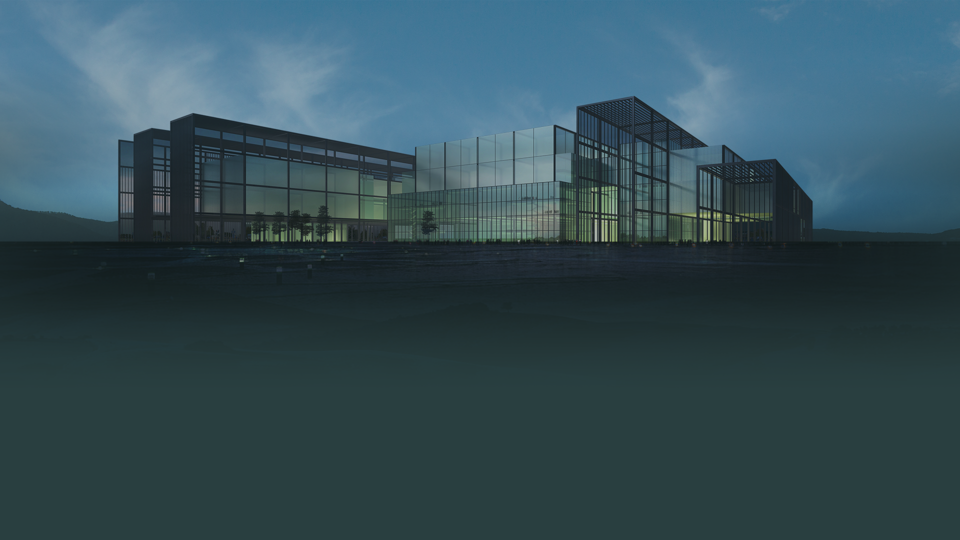
Grow the Business
Improve Bottom Line
Delight Customers
Employee Experience
Strategy
Align work
to strategy
Increase transform
Centralize demand, align to goals
Work:
Waterfall, Agile, SAFe, Hybrid
Deliver measurable outcomes
Decrease Run
Adapt to change
Measure & adjust
ServiceNow Platform
Notes:
So let’s take a look at what this process could look like on a single platform like ServiceNow – HOW DO WE ENSURE THAT WE’RE CONTINUOUSLY DELIVERING ON OUR DESIRED OUTCOMES – IT ALL STARTS W/ ALIGMMENT TO STRATEGY.
We start with the factors impacting your organization.
Let’s take the example of trying to improve the bottom line while growing the business and start by reducing all the overhead of on-prem apps and creating a cloud first initiative.
To make informed decisions about which apps to consolidate and migrate - your planners, service owners, and other teams need operational data accurate and in real-time which you have because it lives in ServiceNow.
We create this ‘as-is’ snapshot using ITBM’s Application Portfolio Management product which allows us to align out current Application to our core Business Capabilities and align that to overall corporate and BU Strategy to guide our investment decisions.
So this creates operational demand to decrease your run costs, so we can start to shift more resources to transform initiatives.
<click>
For growing the business, let’s use a new business services to deliver "direct to consumers".
This is a demand for an entirely new service which is helping transform the business.
<click>
And as you can see, we have a full picture of both operational and strategic demand, which are both tied back to your strategy.
And because you have all this data in your platform we can do this iteratively and as frequently as your business can manage change - monthly, quarterly, and so on.
<click>
From there we can get into executing on this work in traditional projects, agile development, or in the case of most of our customers - a hybrid model.
And now this work is vetted, channeled down to your teams in a unified backlog of work, and tied back to a strategic goal.
<click>
You can see we've thread the needle all the way from strategy to delivery.
This enables us to tie outcomes and value delivered to the business.
<click>
But it doesn’t stop there, any problems, changes, outages or so on is continually collected and measured, so we can learn, and continuously plan and improve.

Slide 6



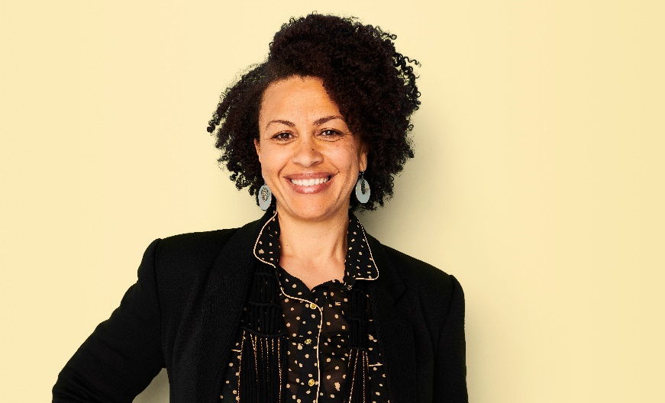


Your entire organization can benefit
Business leaders
Work aligned to strategy
CIO/COO
Manage digital transformation progress
IT strategy & planning
Prioritized investments
Workers
Everything they need in one place
Enterprise architects
Business capabilities tied to strategy
PMO/ePMO
Visibility and speed
IT service delivery
Move from tactical to strategic
Notes:
So we want to always keep an eye on how we are enabling your entire organization to close the gap between strategy and execution of work.
Your business leaders have IT’s work aligned to their strategy
Your CIO can better drive your digital transformation progress
IT Strategy has the connection into the business to optimize investments
Your enterprise architects can align business capabilities to the business strategy
Your PMO has visibility into everything going on so can they can move faster
Your IT Service Delivery isn’t just supporting services but becoming part of the strategic planning and execution conversation.
And ultimately your most important resource, your workers, have everything they need to do their job in a modern and user friendly place.

Slide 7



Work where it matters, accelerate time to value
Strategy and Goals
Application Portfolio
Demand
Management
Resource
Management
Project Financials
Project
Portfolio
Agile
Development
Test
Management
Financial Modeling
Financial
Showback
Application Portfolio Management
Portfolio and Program Management
Application Lifecycle Management/Agile
IT Financial
Management
  CTO, CIO, Enterprise Architecture, VP of Operations, VP of Risk
EPMO, PMO, Strategy & Planning, EVP Products & Innovation, CIO, BRM
Product
Teams
IT Finance
Analyst
Real-Time Visibility into Resource and Financial Management
Common Platform, Data Model, Workflow and Service Framework
Notes:
What does this mean?
In most companies, IT has become a core part of the business. As a result IT has to manage all types of work from delivering internal services - to supporting and delivering innovation around business capabilities - to steering a portfolio of applications.
ITBM helps manage work, people and finance to enable the outcomes the business desires
This encompasses 4 domains: Application Portfolio Management, Project Portfolio Management, Agile Delivery and Financial Management
How have organizations traditionally approached this?...

Slide 8

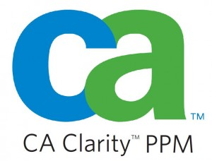
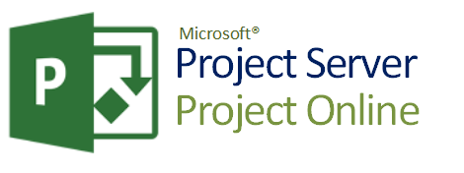
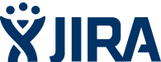
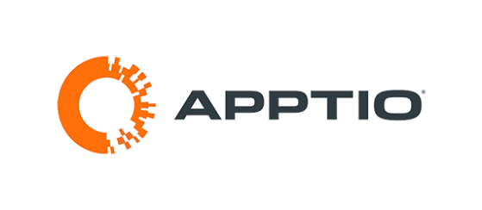
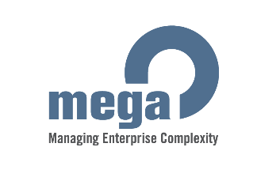
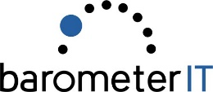
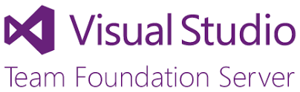
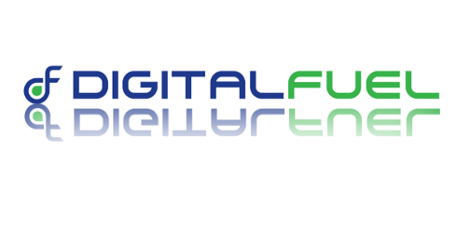

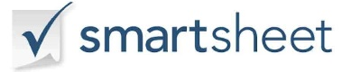

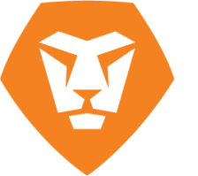


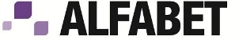
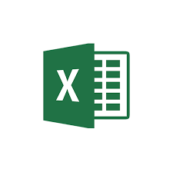
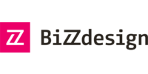
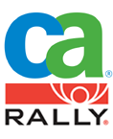

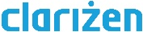


Landscape – reduce complexity
Application Portfolio
Demand
Management
Resource
Management
Project Financials
Project
Portfolio
Agile
Development
Test
Management
Financial Modeling
Financial
Showback
Application Portfolio Management
Portfolio and Program Management
Application Lifecycle Management/Agile
IT Financial
Management
Notes:
What does this mean?
In most companies, IT has become a core part of the business. As a result IT has to manage all types of work from delivering internal services - to supporting and delivering innovation around business capabilities - to steering a portfolio of applications.
ITBM helps manage work, people and finance to enable the outcomes the business desires
This encompasses 4 domains: Application Portfolio Management, Project Portfolio Management, Agile Delivery and Financial Management
How have organizations traditionally approached this?...

Slide 9
Work where it matters, accelerate time to value
Strategy and Goals
Idea Portal
Ensure only right ideas proceed
Align to Strategy & Goals
Optimize portfolio inline with Priorities & Constraints
Strategic
Product, Program, Project, Epic
Application Portfolio
Demand
Portfolio
Change
Release
Technology Portfolio
RTB
Waterfall, Agile, Hybrid
Business Capabilities
Estimate Demand
Operational
Fast Track
Application and service lifecycle
Notes:
Within ITBM are 3 basic applications
IT Financial Management – To provide an IT context on dollars spent in IT vs. relying on finance account codes and cost center information
Application Portfolio Management – To ensure Applications are aligned with business capabilities and business strategy
Project Portfolio Management and Agile Deliver- Managing all work within IT and the associated project portfolios
ServiceNow is the only vendor that offers all of these capabilities on the same platform. Thereby allowing our customers to readily share data across these solutions for better decision making and managing an end-to-end process within IT.

Slide 10
Deliver business outcomes with speed and agility
Notes:
Today we want to talk to you about Delivering Business Outcomes with Speed and Agility on the ServiceNow platform.

Slide 11

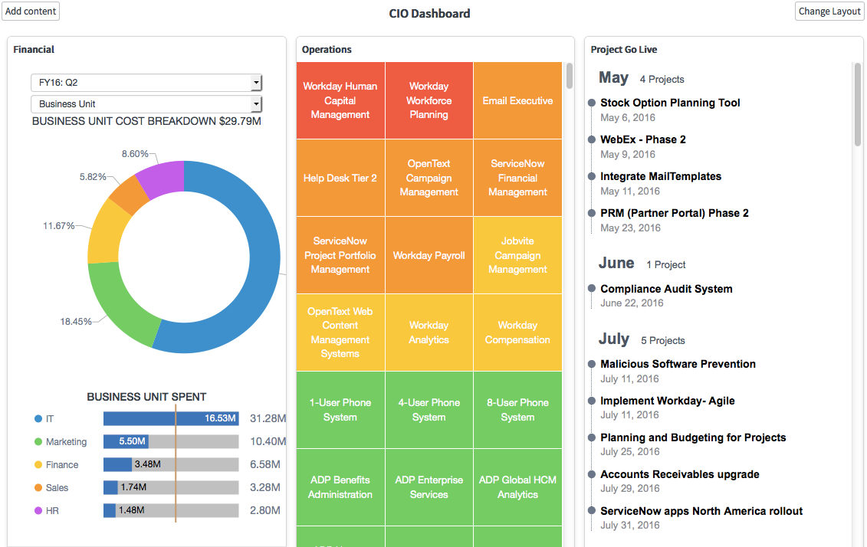
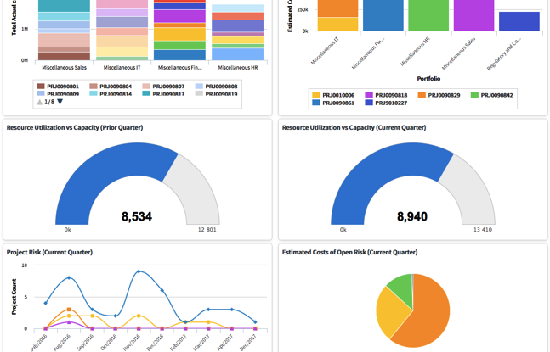
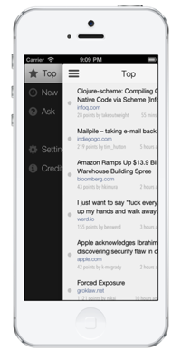
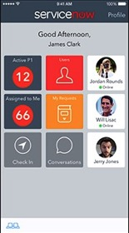
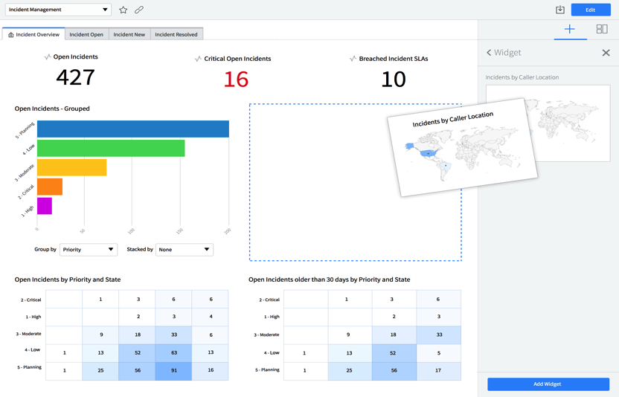
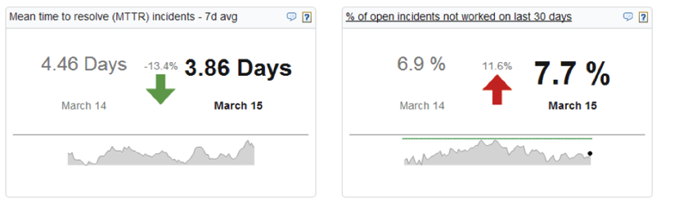
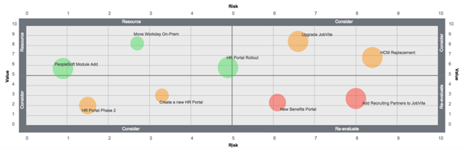
Management – Dashboard & Reporting
Objectives
Give visibility to all actors on their own Business metrics and KPIs.
Give users the ability to create reports through drag & drop.
Publish to various formats.
Capabilities
Create reports and dashboards from every screen or form.
Intuitive report workbench with drag & drop capabilities.
Interactive and real time reports.
Why ServiceNow
Communication of reports to the portal and multi-channel publishing.
In-platform analytics available to monitor and predict performance.

Slide 12
The Role of Planning is Changing in Enterprises
Agile Organization
Outcomes
Own this
CTO / CIO / CDO / CPO
Continuous planning
Tops down
Strategy driven
SPO
Strategy mapped to execution
PPM Organization
VMO
Product/Outcome driven
Maturity
CIO, Director of PMO
Annual planning
Bottoms up
EPMO
Enterprise project intake
IT PMO
Demand Intake
Outputs
Service Provider/Cost center
Business Participation in IT
Strategic Driver
Notes:
The “traditional” organization (designed primarily for stability) is a static, siloed, structural hierarchy – goals and decisions flow down the hierarchy, with the most powerful governance bodies at the top (i.e., the top team). It operates through linear planning and control in order to capture value for shareholders. The skeletal structure is strong, but often rigid and slow moving.
In contrast, an agile organization (designed for both stability and dynamism) is a network of teams within a people-centered culture that operates in rapid learning and fast decision cycles which are enabled by technology, and that is guided by a powerful common purpose to co-create value for all stakeholders. Such an agile operating model has the ability to quickly and efficiently reconfigure strategy, structure, processes, people, and technology toward value-creating and value-protecting opportunities. An agile organization thus adds velocity and adaptability to stability, creating a critical source of competitive advantage in volatile, uncertain, complex, and ambiguous conditions.

Slide 13
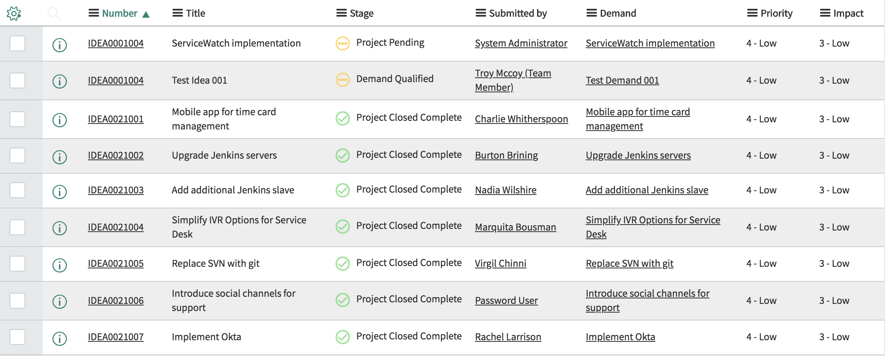
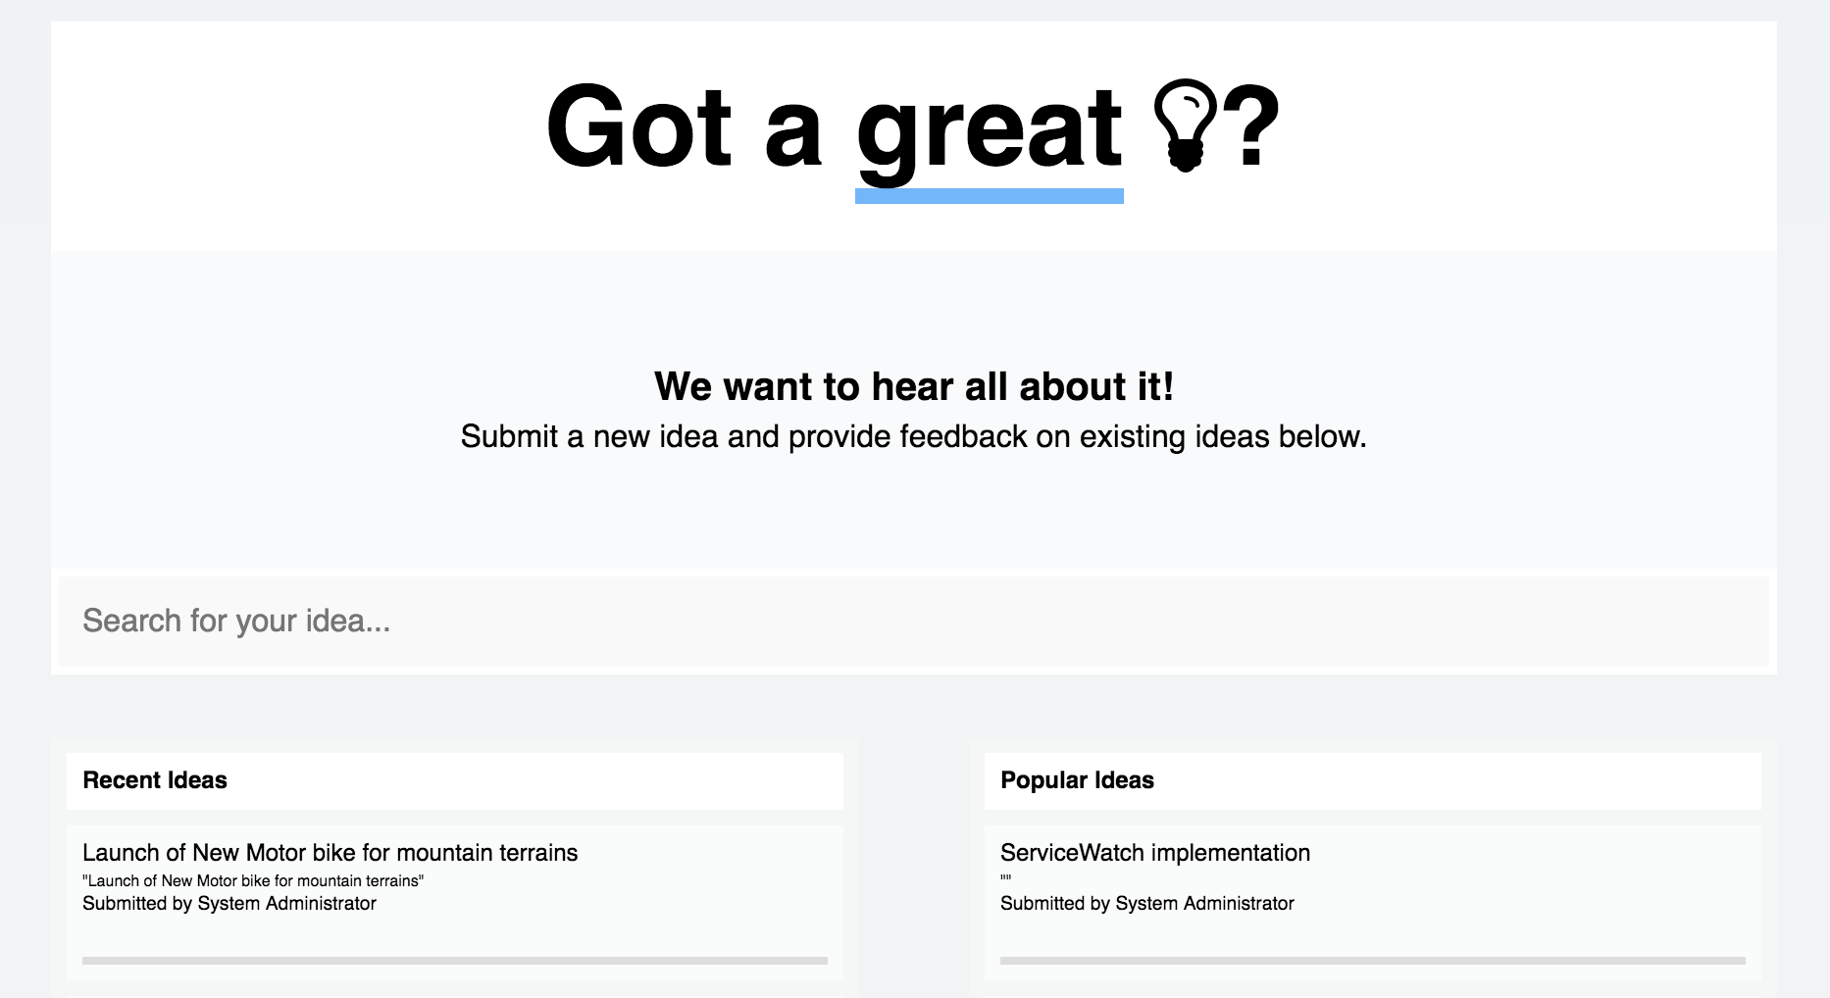
Ideation
Objectives
Collect ideas through a unique communication channel, front door to IT.
Bring visibility to the requestor on the whole idea lifecycle.
Capabilities
Single entry point for collecting ideas within a user configurable portal.
Conversion of ideas to demands for further arbitration and execution.
Why ServiceNow?
Submission of ideas in an informal fashion, dashboard and progress from a single customer portal.

Slide 14
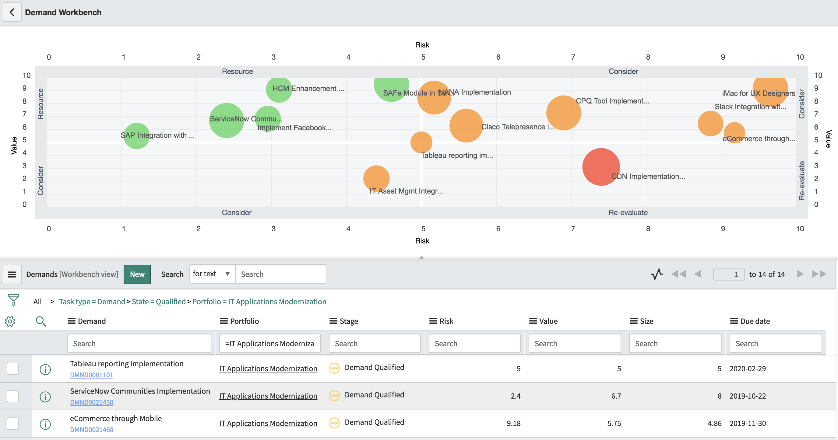
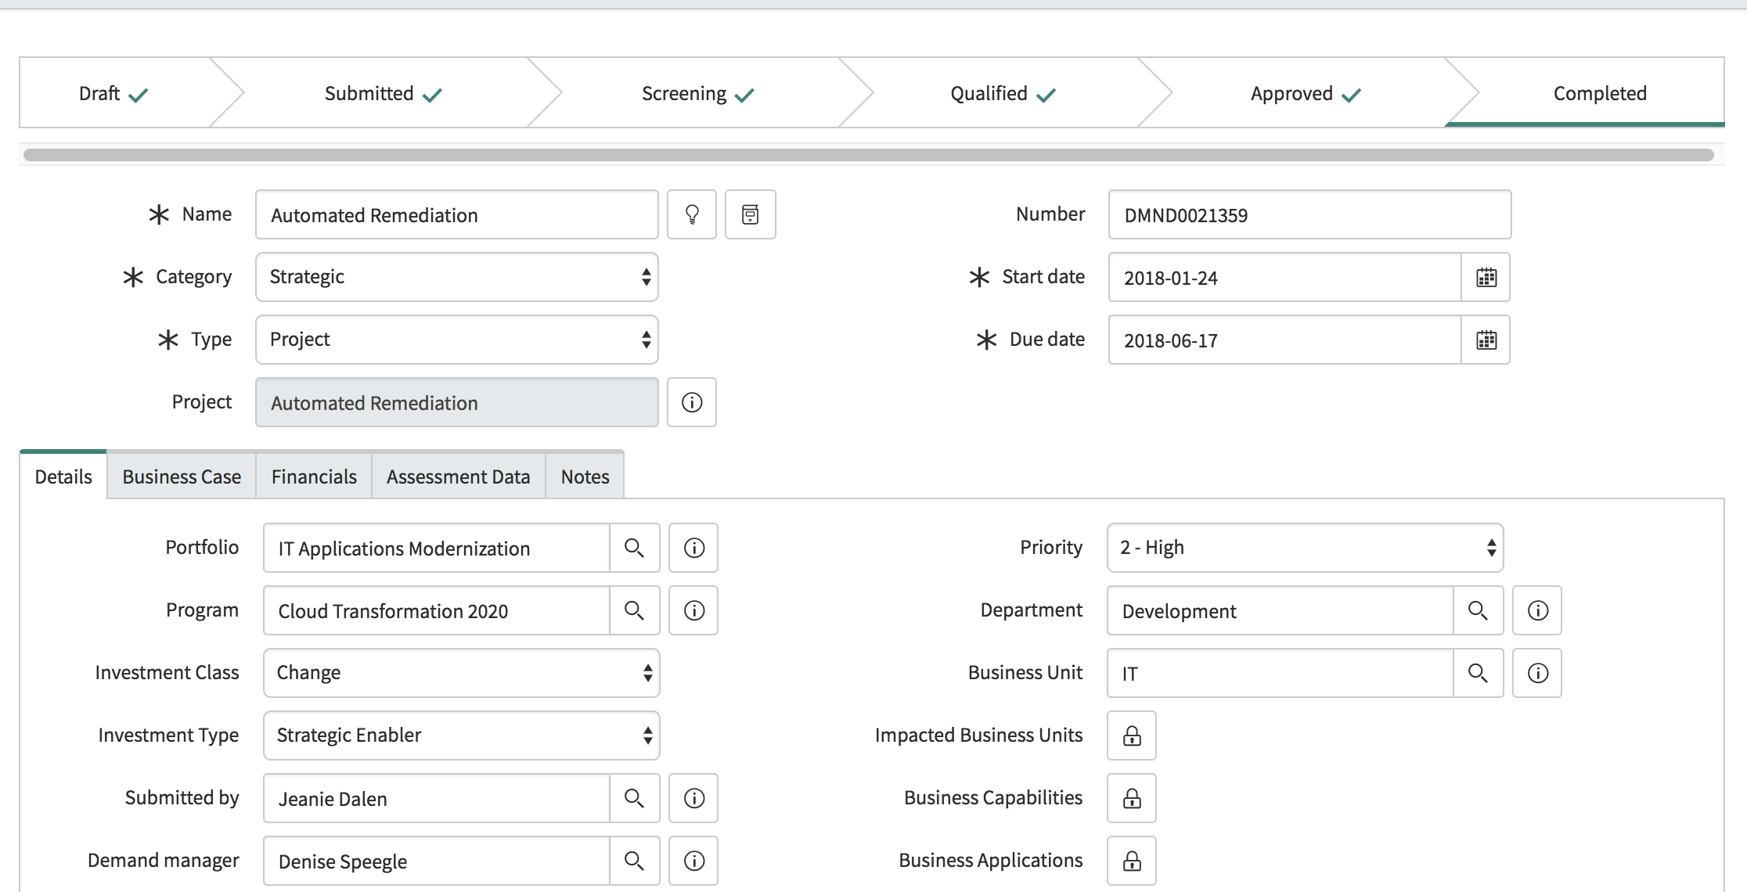
Demand Management
Objectives
Centralize Business and IT demands.
Structure and rationalize decision process for new products and services.
Facilitate project initiation for efficient execution.
Capabilities
Demand screening through assessment questionnaires.
Work alignment on goals and strategy, through demand arbitration / prioritization.
Demand grouping and conversion to projects, enhancements, changes, …
Why ServiceNow
Submit ideas and demands through a single portal.
Direct link to operational activities (Project, Software Dev., ITSM).

Slide 15
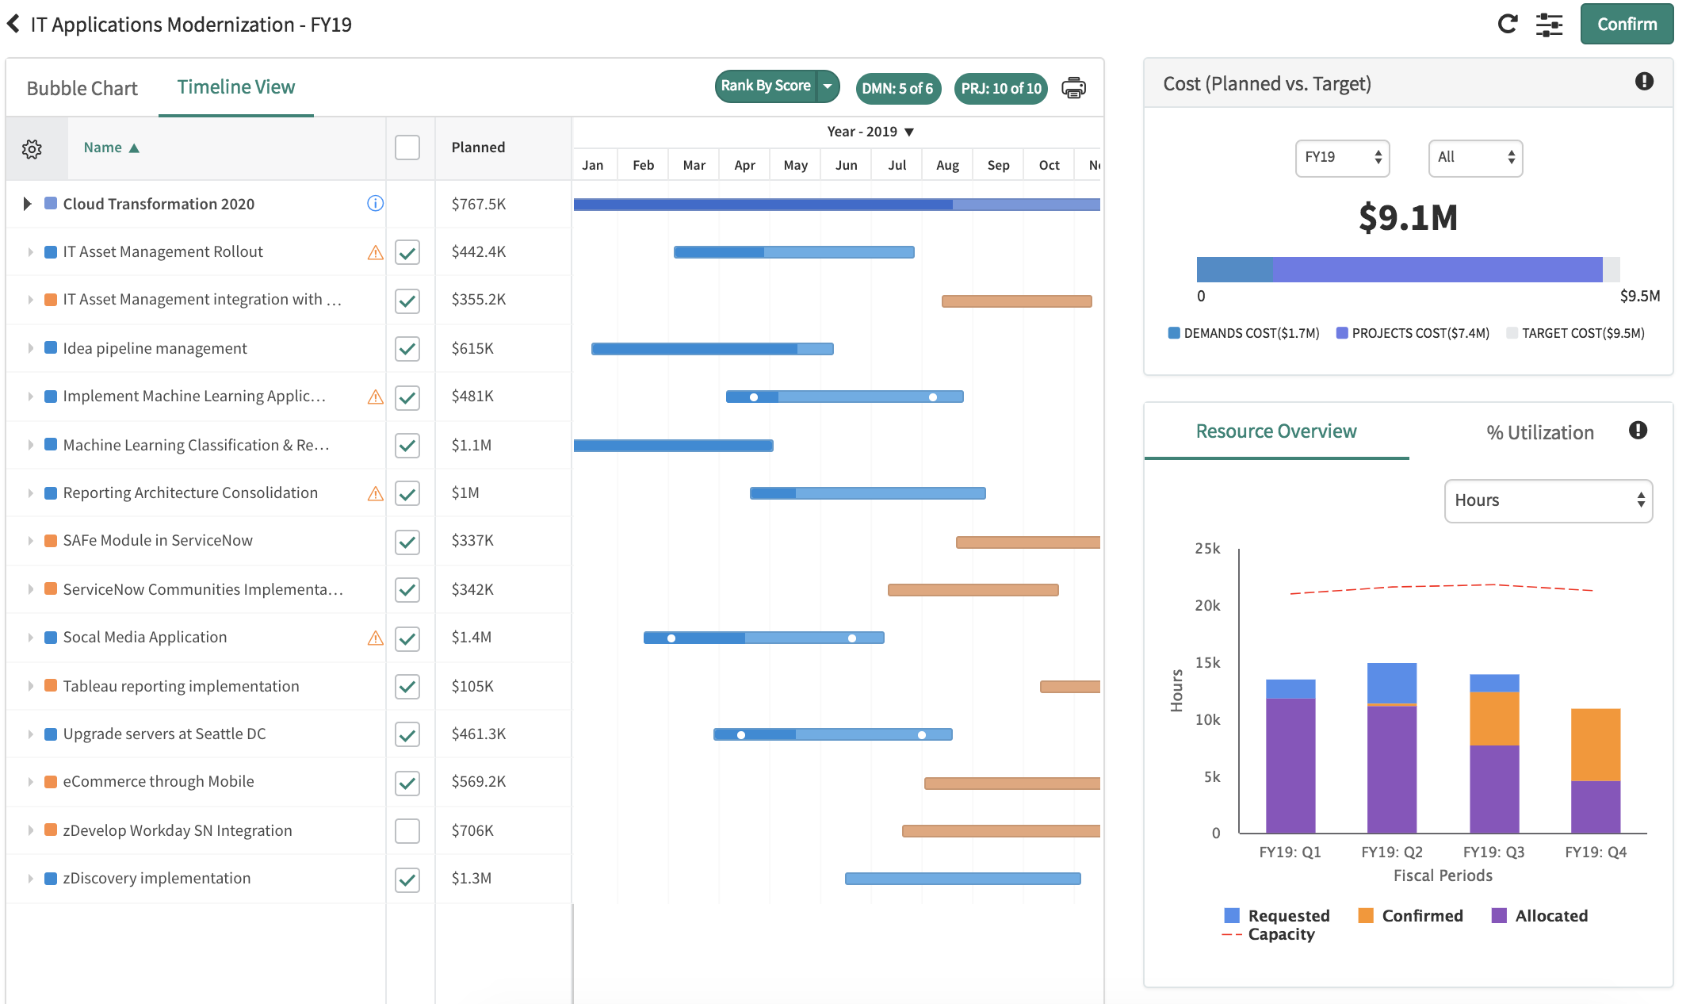
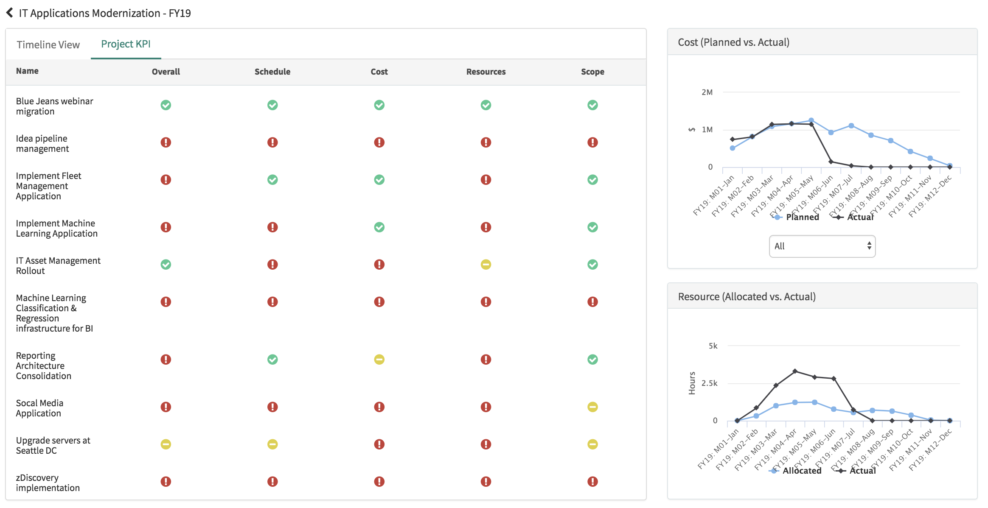
Portfolio Management
Objectives
Inventory of potential projects and opportunities.
Align investments on business objectives.
Track project performance.
Capabilities
Project arbitration on factual metrics (budget, resource, priority, value, …)
Monitor project KPIs.
Formalize decisions and communicate to stakeholders.
Investment Portal - This is an intuitive status reporting portal designed to provide real-time visibility / tracking of work across the end to end lifecycle.
Why ServiceNow
Centralized strategic management for all Business and IT activities
Budget planning and allocation, aligned with corporate objectives

Slide 16
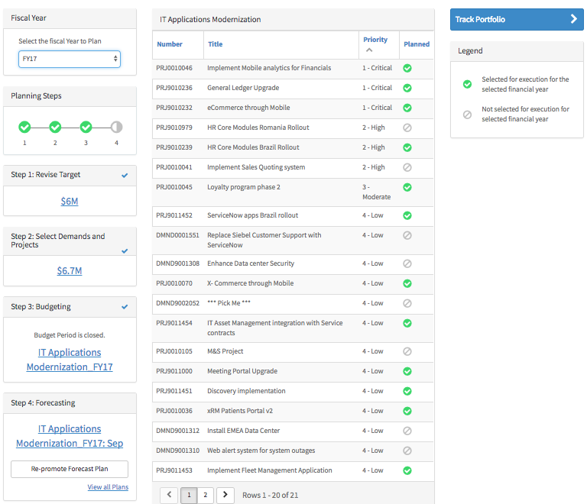
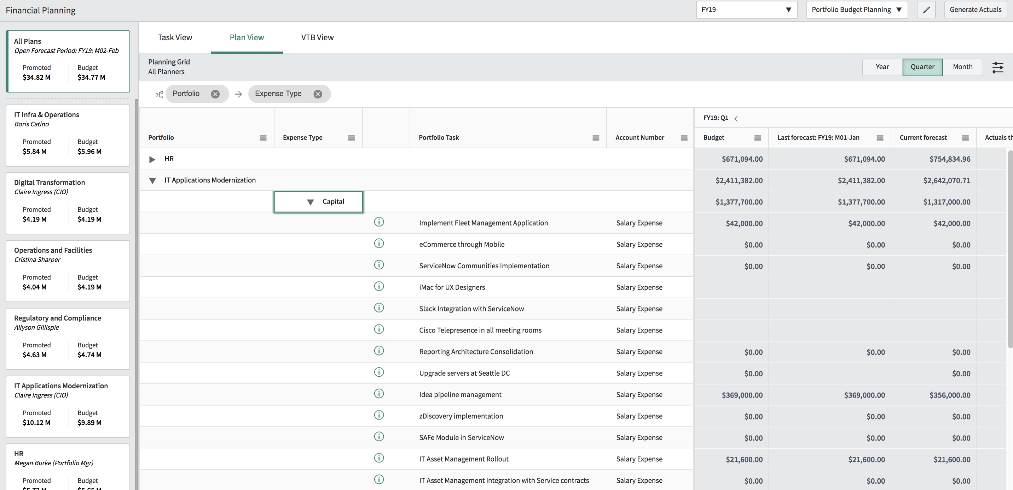
Financial Planning
Objectives
Plan budget on activity (project/non-project) and services (IT/Business).
Define budget lines by typology and activity, for comparison with actual expenses.
Capabilities
Multi-currency budget plans on various fiscal periods.
Approval and forecasting Workflow processes.
Investment Portal: provide real-time visibility of work across the end to end lifecycle.
Financial Baselines: Capturing a snapshot of Financials for Project/Demand.
Why ServiceNow
Collaborative budget management, for cross-financial planning on service and activity.

Slide 17
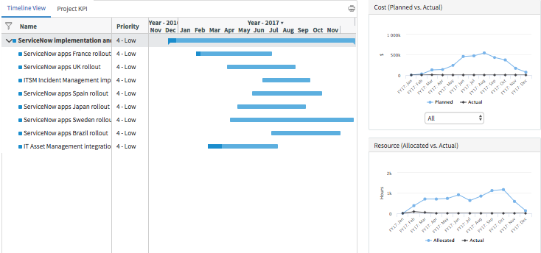
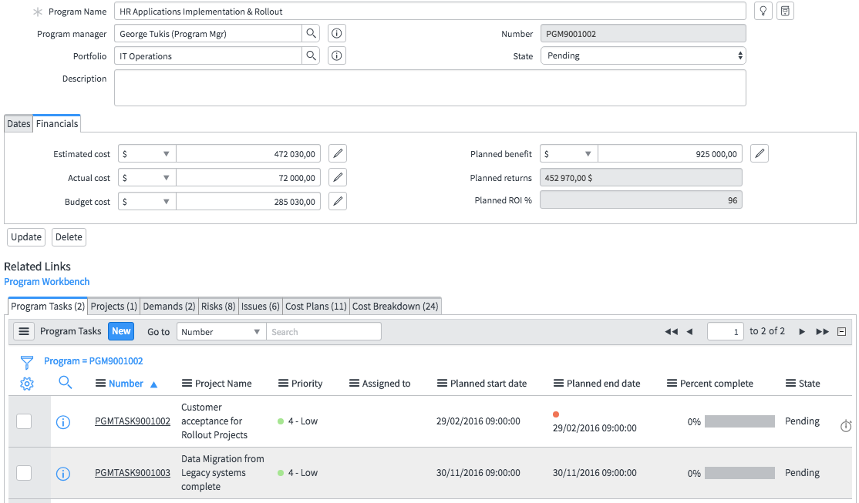
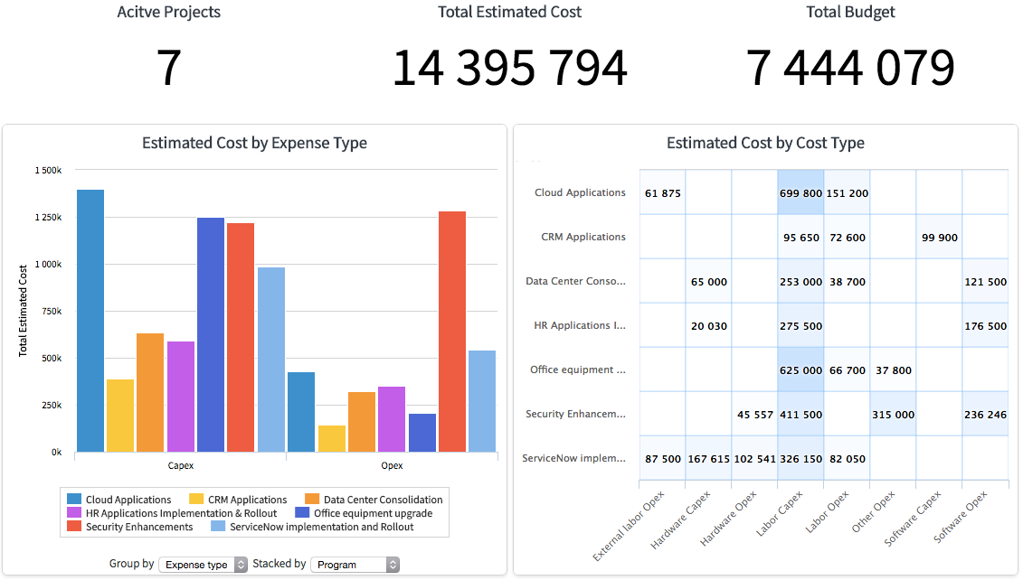
Program Management
Objectives
Aggregate and support business objectives through operational programs.
Coordinate and manage projects dependencies.
Capabilities
Centralized program management through workbench.
Program KPIs and key milestones tracking.
Scheduling of coordination tasks and milestones.
Why ServiceNow
Single strategic management for all Business and IT programs.
Management of multi-level KPIs and metrics (project / program).
Financial monitoring.

Slide 18
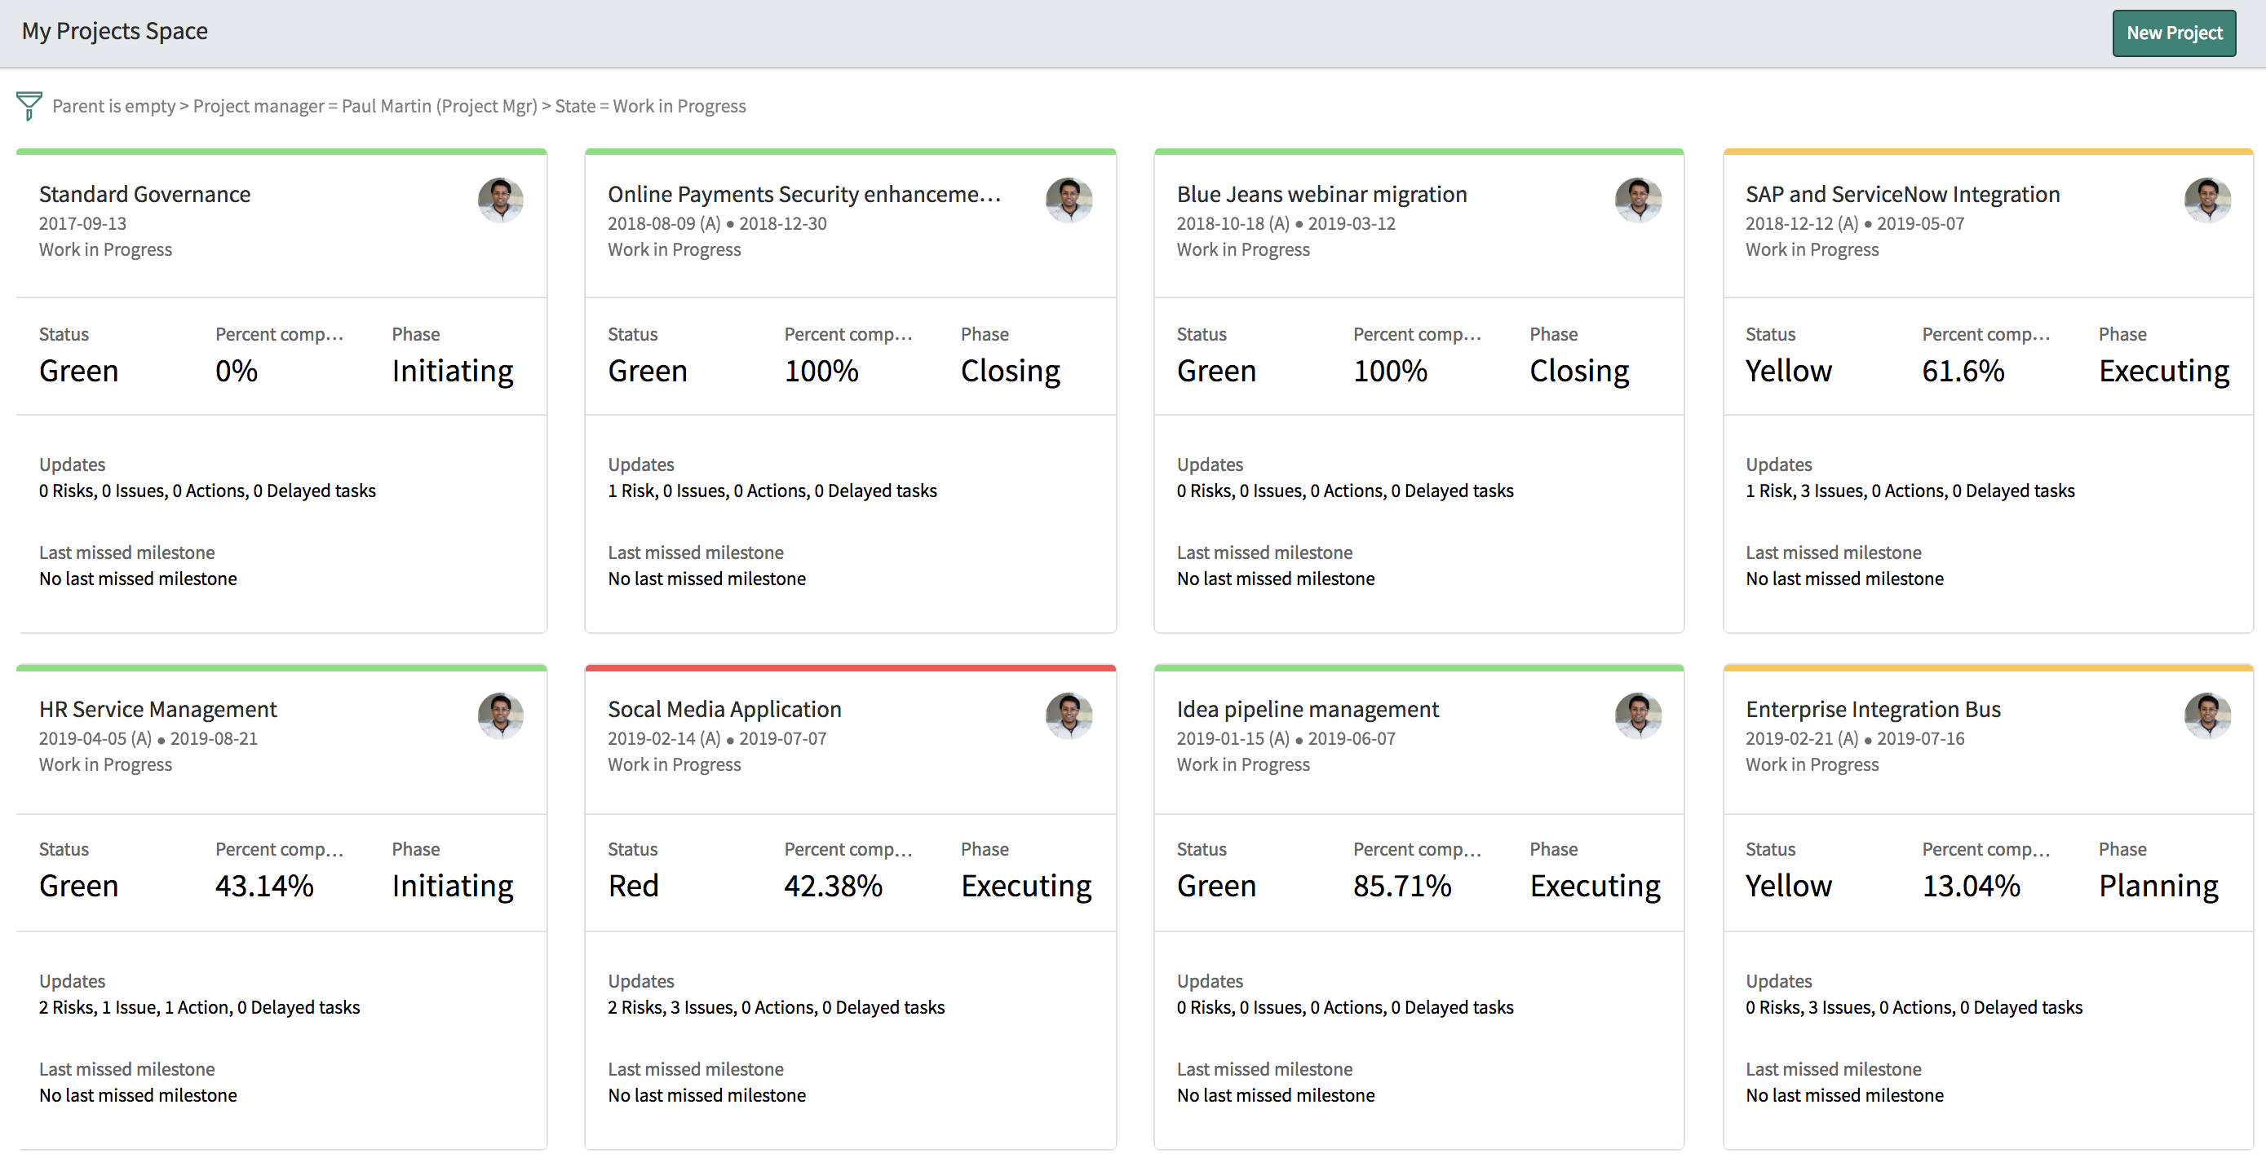
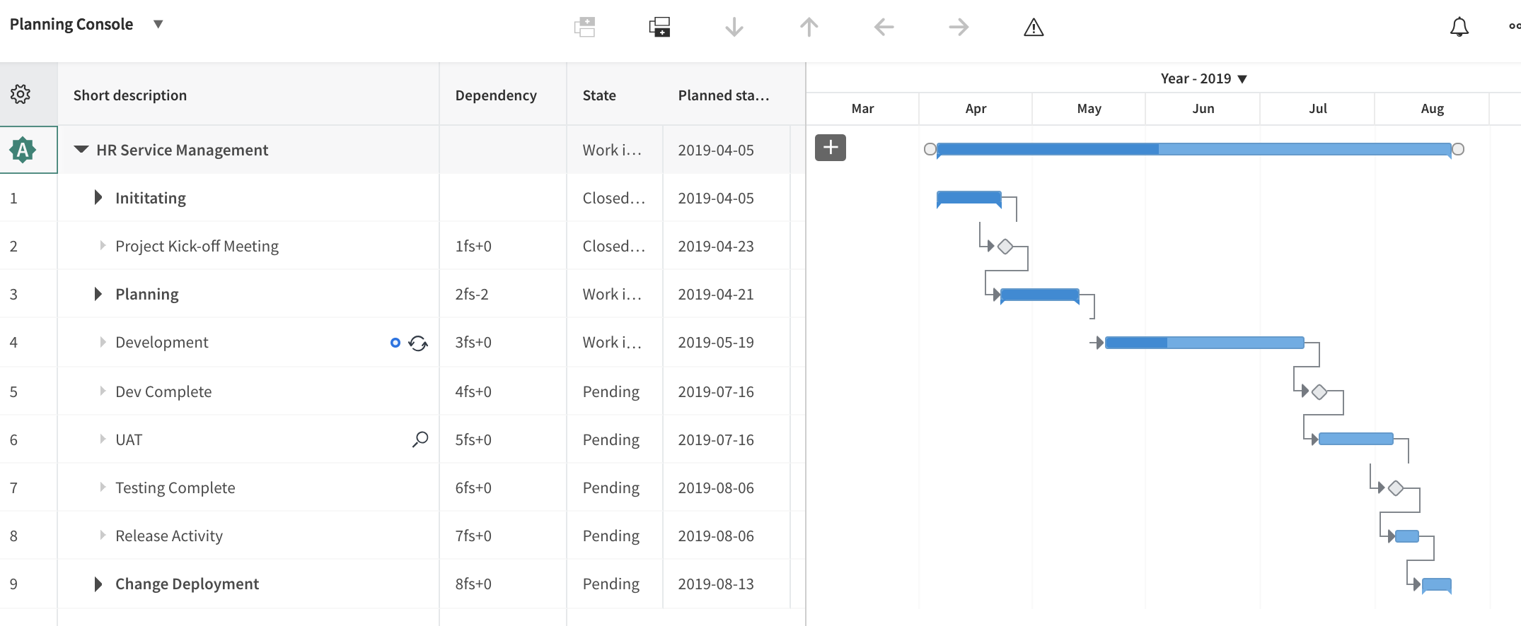
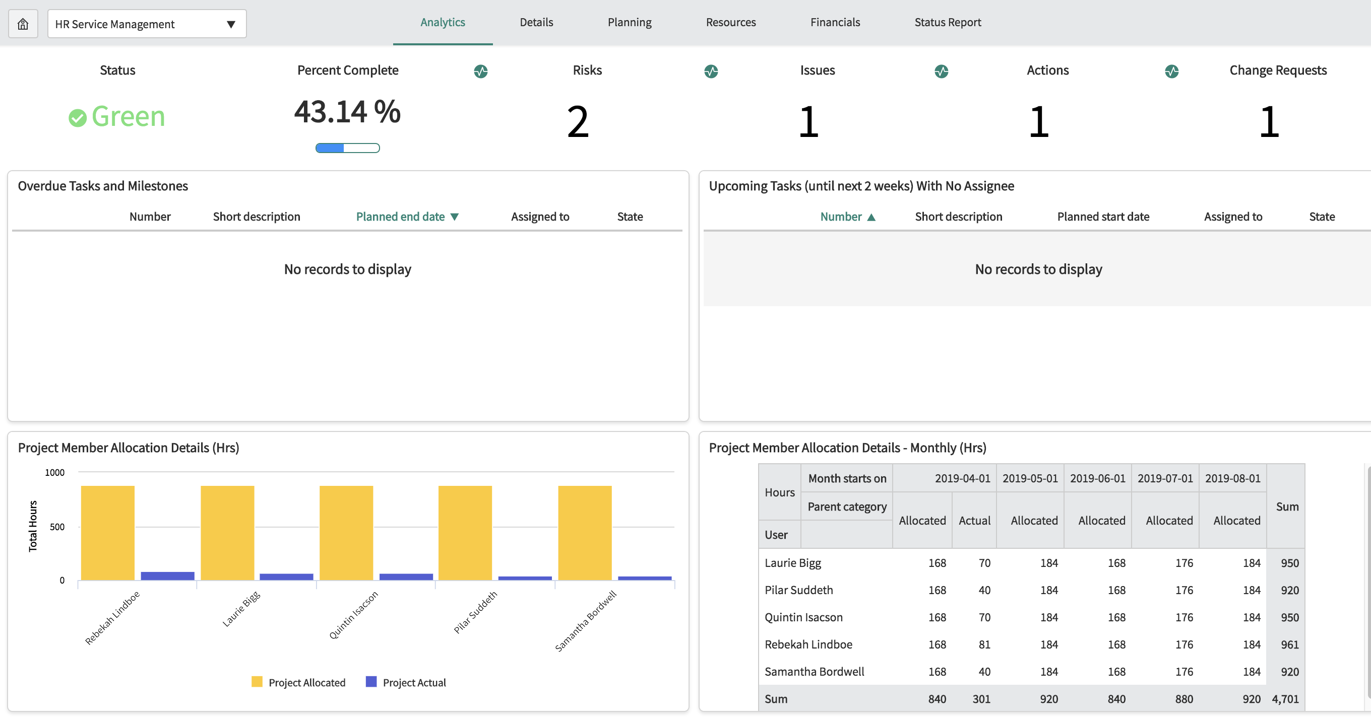
Project Management
Objectives
Build project plan and manage execution.
Track project KPIs.
Increase ratio of projects delivered on time.
Capabilities
Full operational management: status reports, risks, issues, change request, actions, deliverables, schedules, financial and resource planning .
Value-added and configurable reports (Roadmaps, Gantt, Visual Task Boards, …)
Bi-directional integration with MS Project.
Why ServiceNow
Single platform for PPM, incidents, changes, releases, SDLC, documents, demands, …
Support for multi-team and collaborative methodologies.

Slide 19
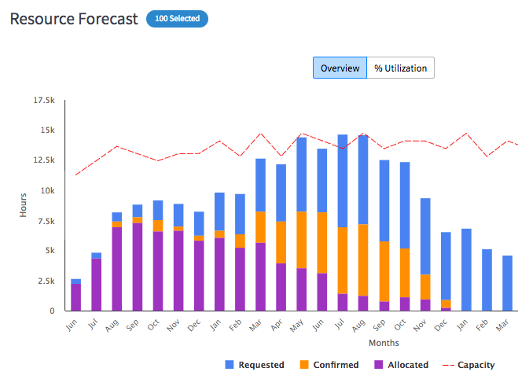
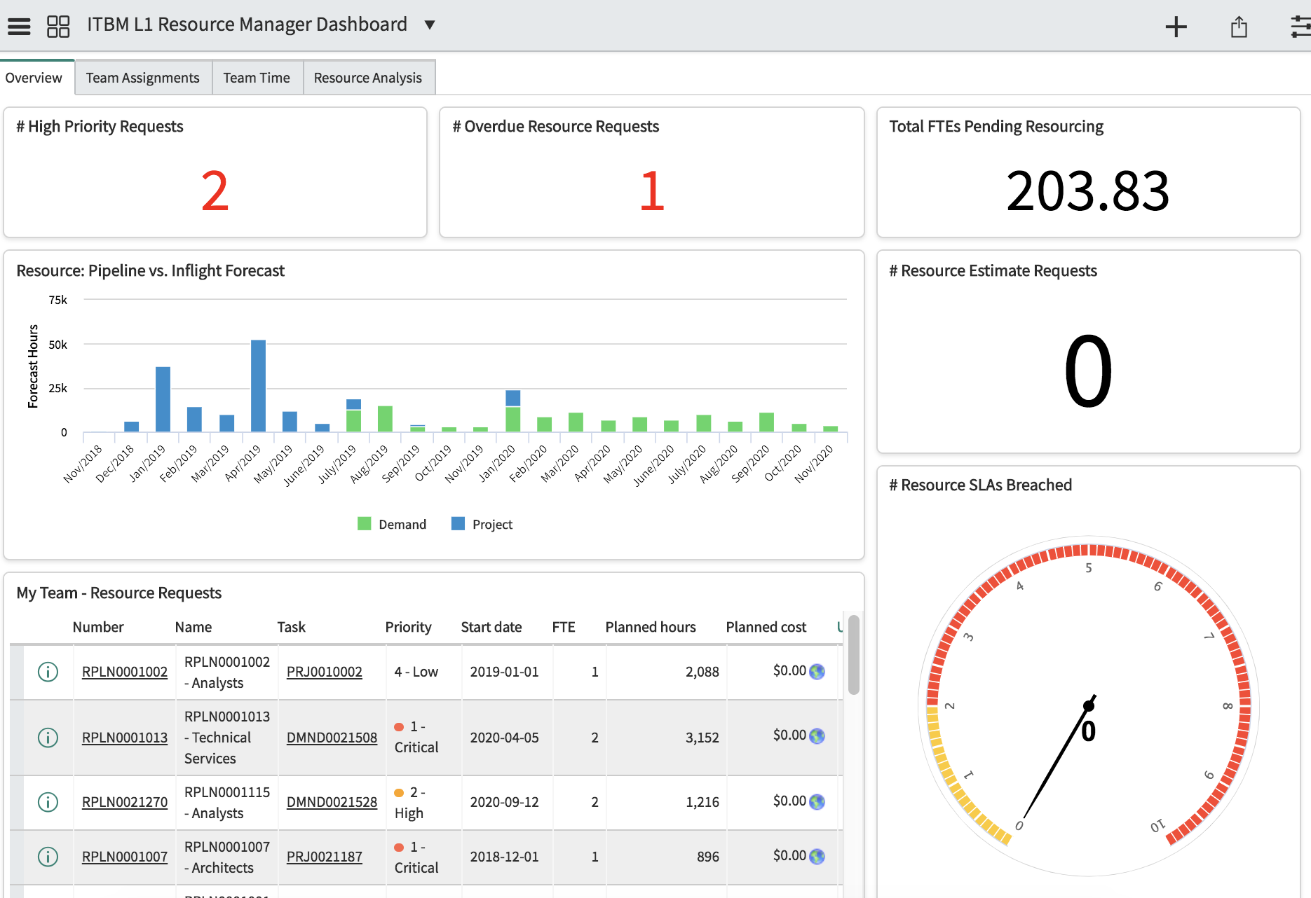
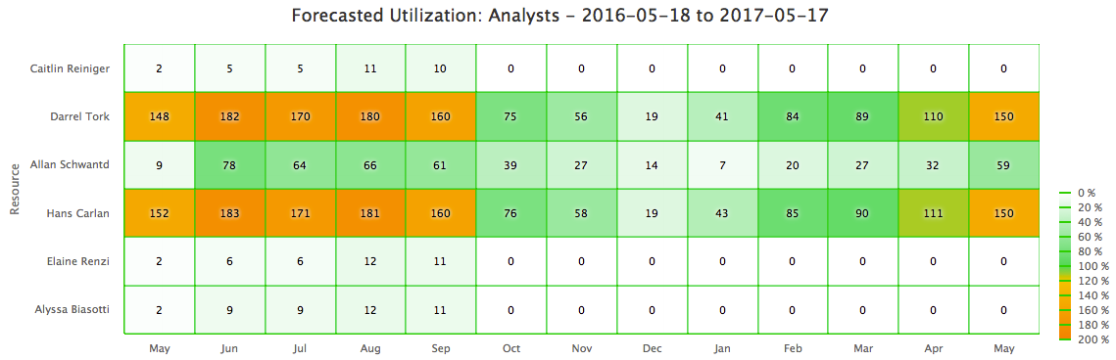
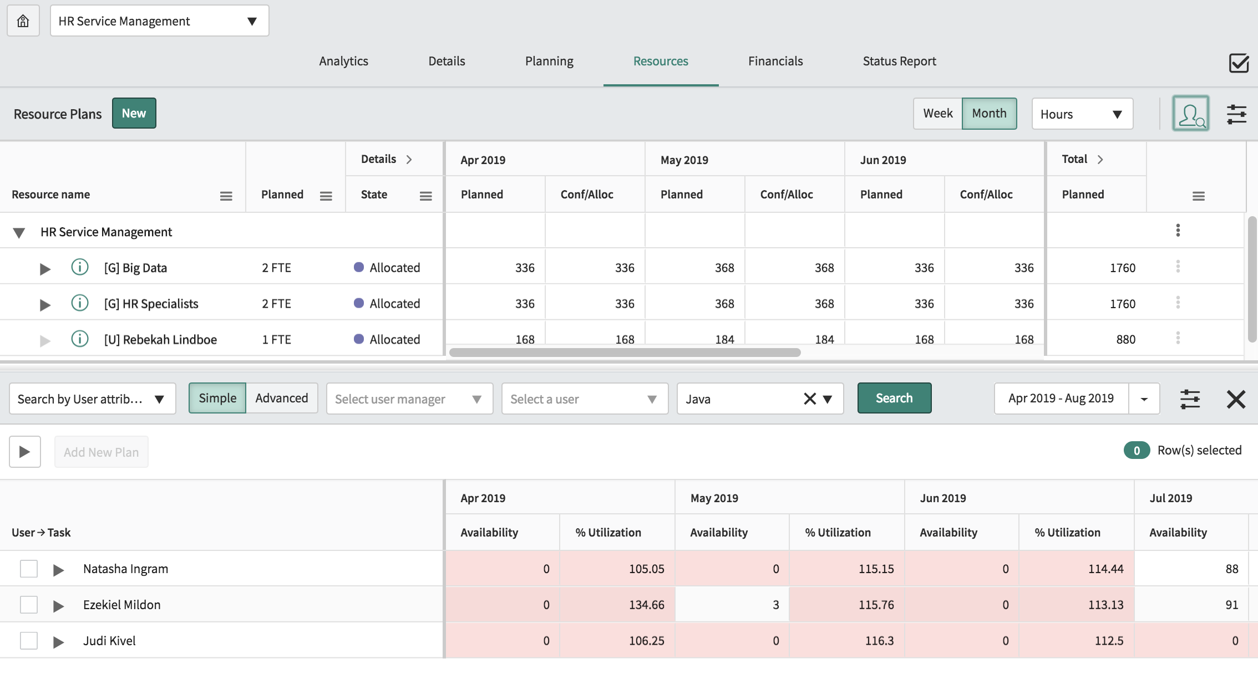
Resource Management
Objectives
Plan resource contribution and usage for any kind of activity (project, change, run, administrative, training, etc..)
Create skill cartography.
Track overall and detailed resource usage.
Capabilities
Real time monitoring and allocation of shared resource demands.
Calendar, schedule and time tracking
Arbitration and leveling on resource usage and availability
Resource “Allocation Workbench” to view one or many groups under their management.
Why ServiceNow
Cross resource management /Timesheet / group allocation / project.
Weekly / monthly monitoring of capacity plans and forecasts.

Slide 20
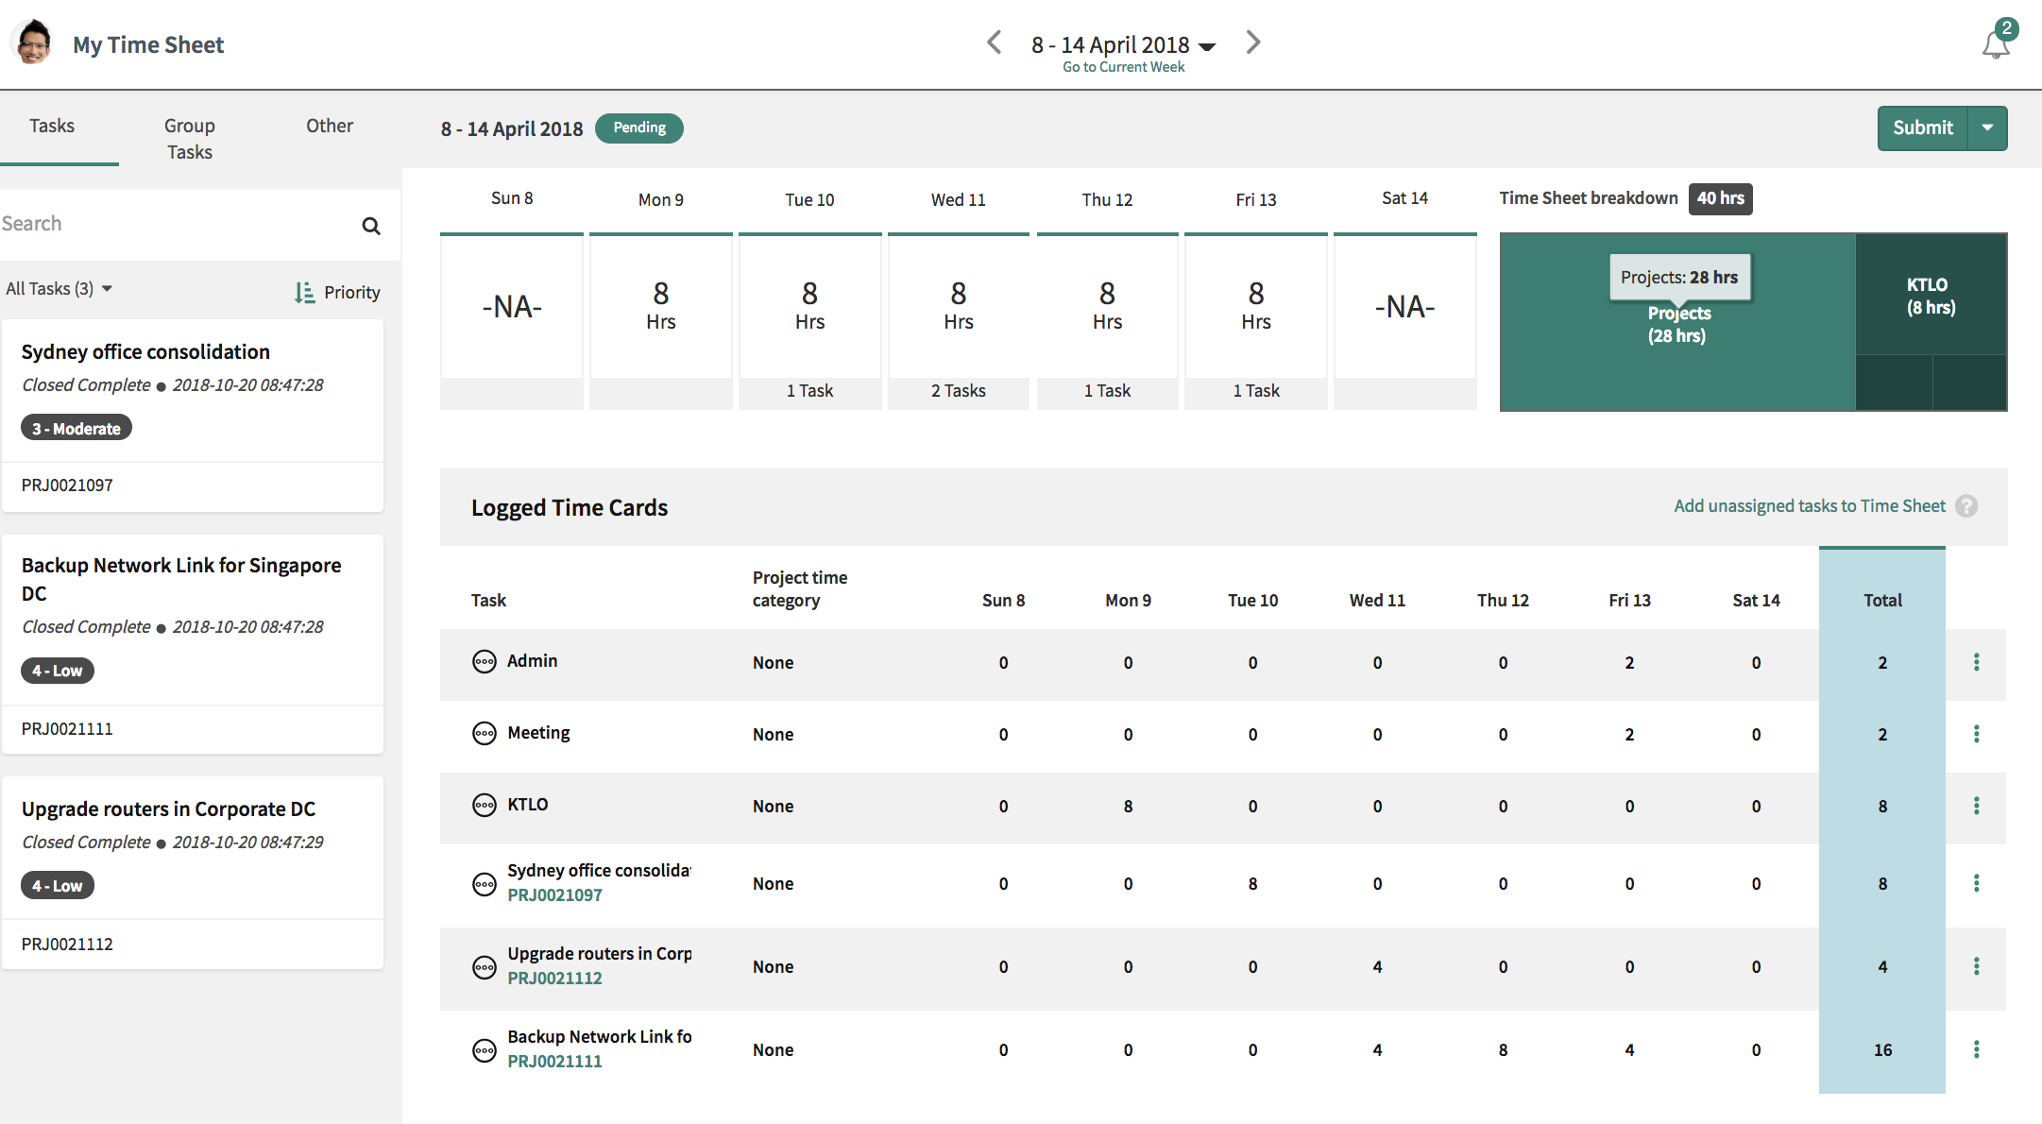
Time Management
Objectives
Time writing to capture actual effort, actual allocations and actual labor cost.
Capabilities
Time Sheet Portal: allows users to submit time in an easy intuitive way.
Time tracking against project, changes, incidents, task...
Timesheet delegation features.
Approval workflows and system notifications.
Why ServiceNow
Cross resource management /Timesheet / group allocation / project.
Cross resource with ITSM or other products in the platforms.

Slide 21
Management – Dashboard & Reporting
Objectives
Give visibility to all actors on their own Business metrics and KPIs.
Give users the ability to create reports through drag & drop.
Publish to various formats.
Capabilities
Create reports and dashboards from every screen or form.
Intuitive report workbench with drag & drop capabilities.
Interactive and real time reports.
Why ServiceNow
Communication of reports to the portal and multi-channel publishing.
In-platform analytics available to monitor and predict performance.

Slide 22

Thank you

